Slide 1

Project Title Report Development using Jasper
CAPSTONE PROJECT
Group Members:
Abhishek Pal
Abhit Gahlot
Chinmaya Kumar Bansal
Divya Chadha
Kashish Chaurasia

Slide 2
Objectives
The goal of our project is to generate reports of sales data of mobile companies using jasper.
The product here will contain various kinds of mobile and it’s accessories.
From pre-defined options that are present in the GUI, the user will be able to select the data that is required by him/her.

Slide 3
Objectives-Jasper
The objective of using jasper is to fetch data from a database through java code and generate the report in the format desired by the user.

Slide 4
Work Done So Far
The Front End has been completed with all the connections.
The user has to sign in now to access the Report making page.
The user can logout whenever he/she wishes.
The username and password are verified using the data present in the database.

Slide 5
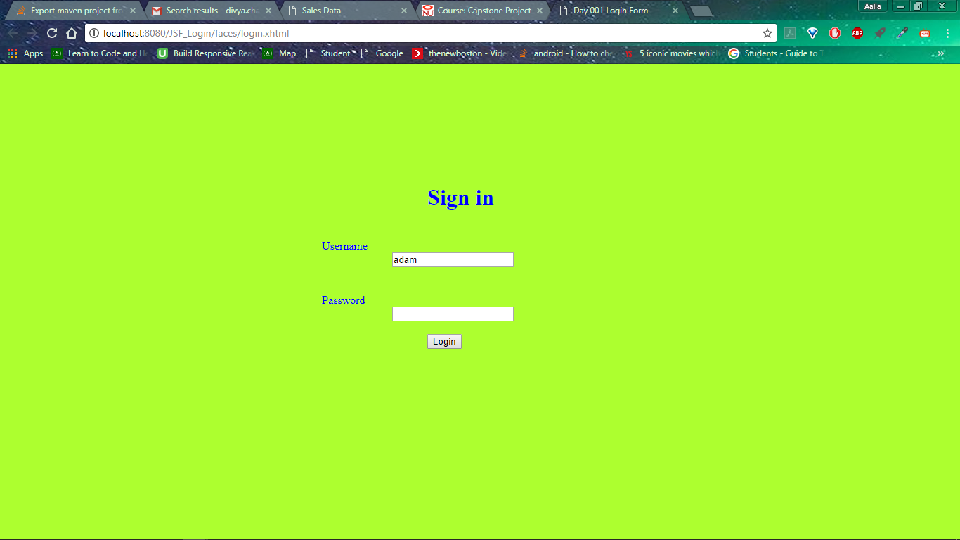

Slide 6
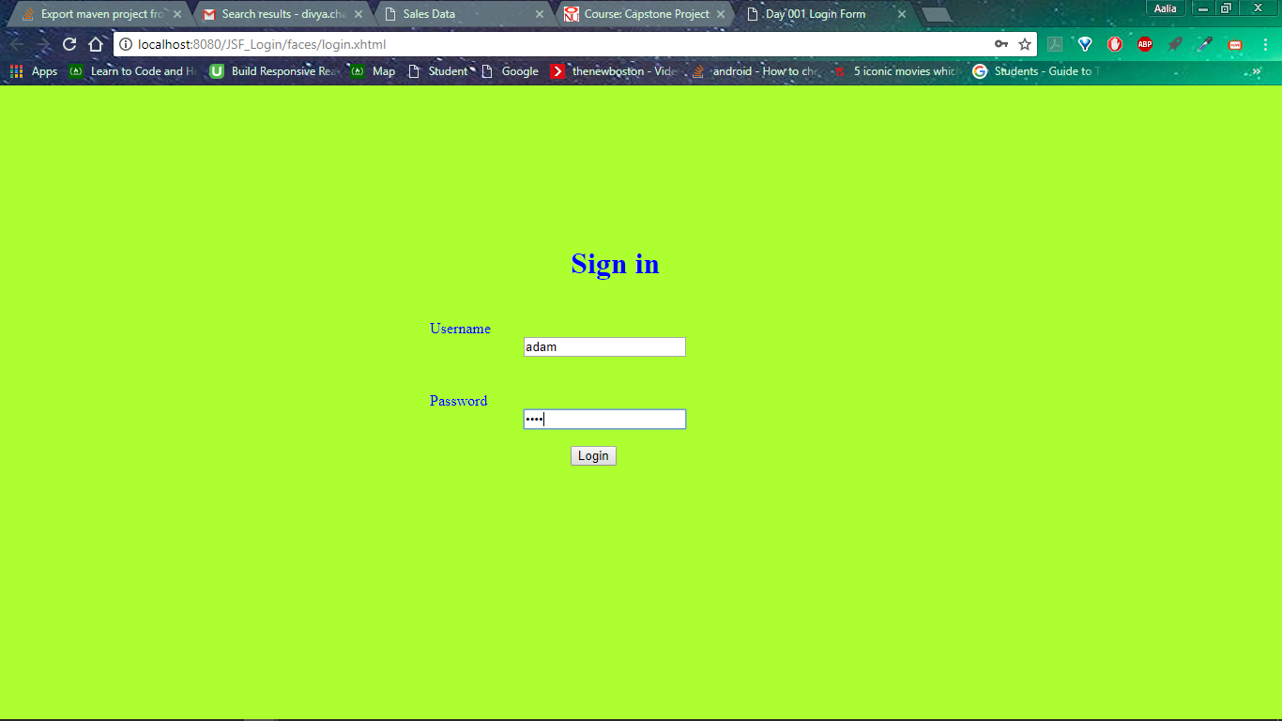

Slide 7
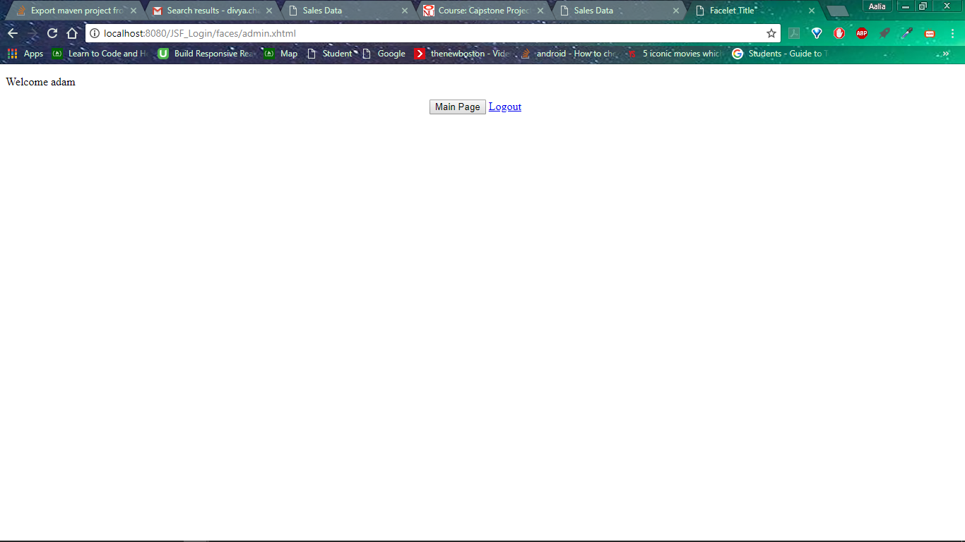

Slide 8
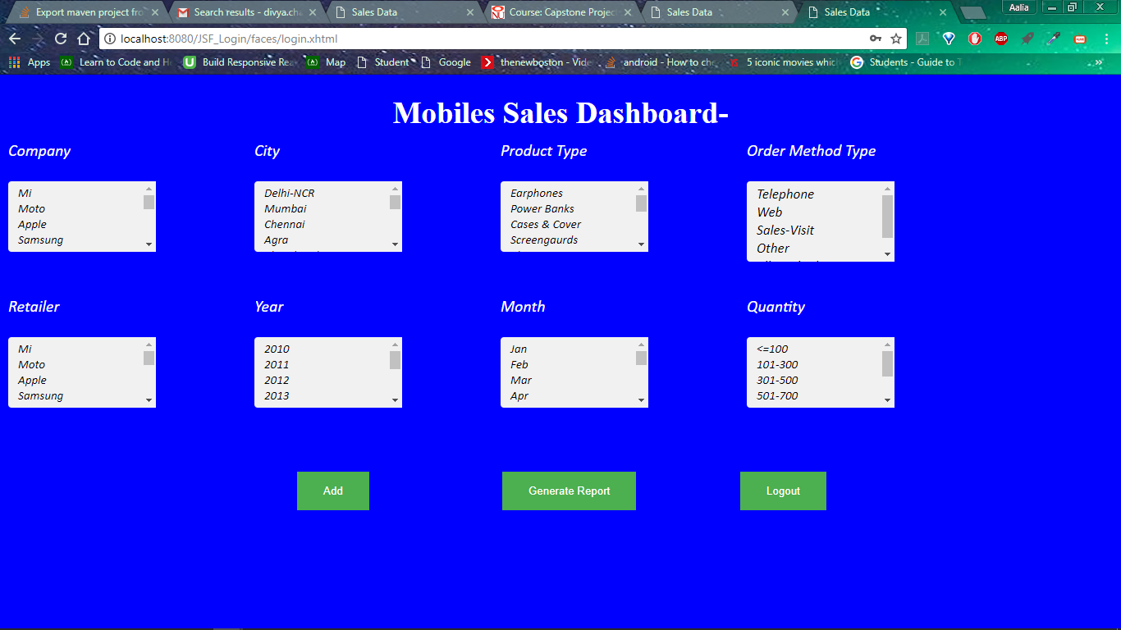

Slide 9
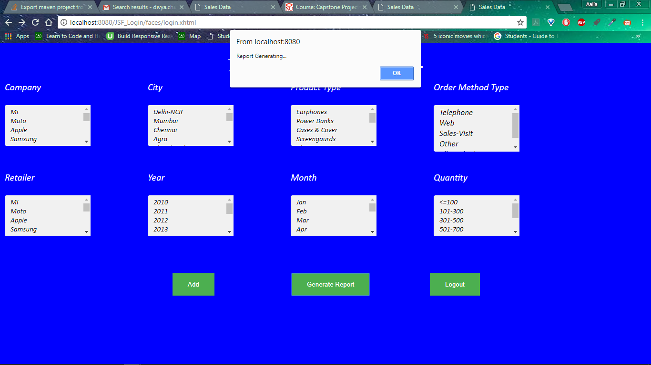

Slide 10
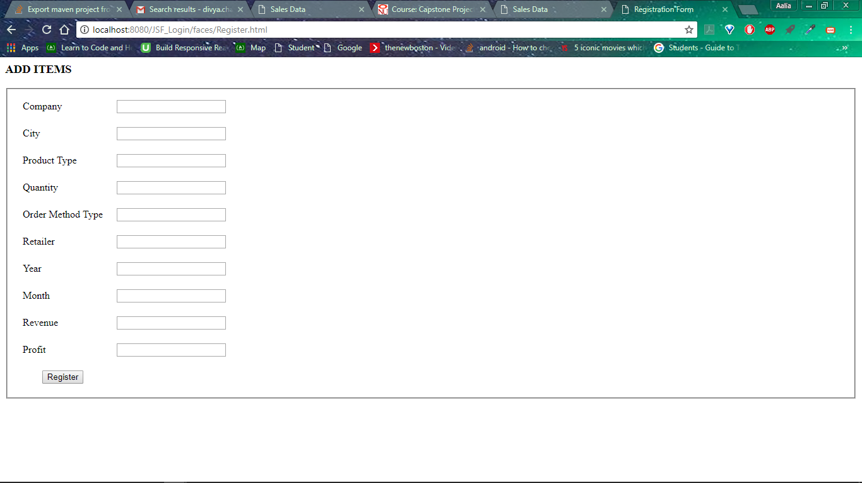

Slide 11
Work Done So Far
Some sample reports have been generated using the Jaspersoft Studio.
These jrxml reports are currently in a static frame.
The Reports requested by the user will be available if and only if the template of the said report is available.

Slide 12
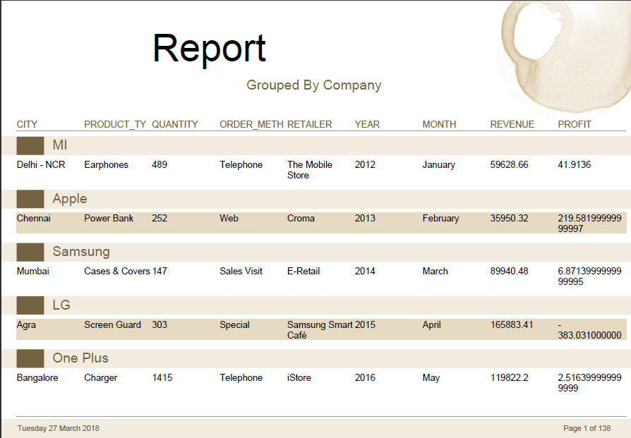

Slide 13
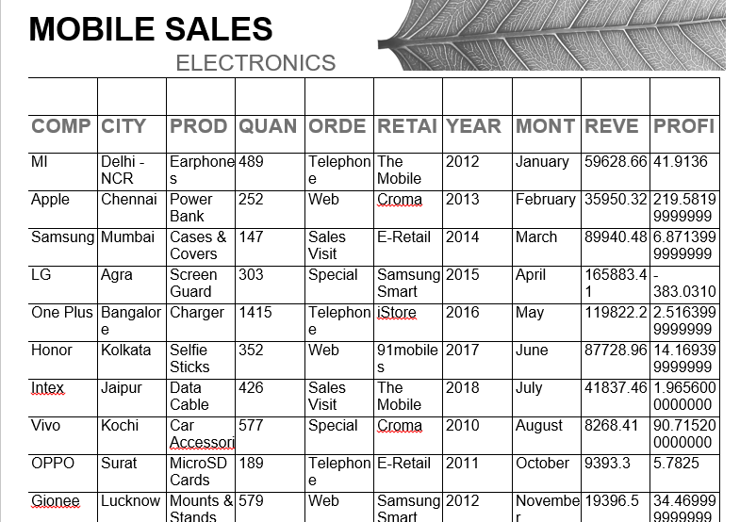

Slide 14
Work Done So Far
The Java code which will connect the java the front end with the sample reports has been completed.
But the current code is in static form.
The java code which will make the process of report generation dynamic is currently in the works.

Slide 15
Technologies Being Used
TextPad8
Eclipse
Microsoft Excel
Tomcat8
HTML/CSS
JasperSoft Studio
HTML/CSS
JSP Servlets
Java

Slide 16
Members | Responsibilities
Divya & Kashish | Login page Development & GUI Development Static Report Generation with Jaspersoft Studio Database Handling
Chinmaya | Report generation using Jaspersoft studio GUI development
Abhit & Abhishek | UI development using HTML/CSS

Slide 17
Work Left
The back end coding which will combine everything dynamically.
Final touches to the UI.
The Jasper Reports that will be made will be available to the user as a downloadable file or will be shown on the desktop.

Slide 18
Thank You!

